Slide 1


Professional English

Slide 2
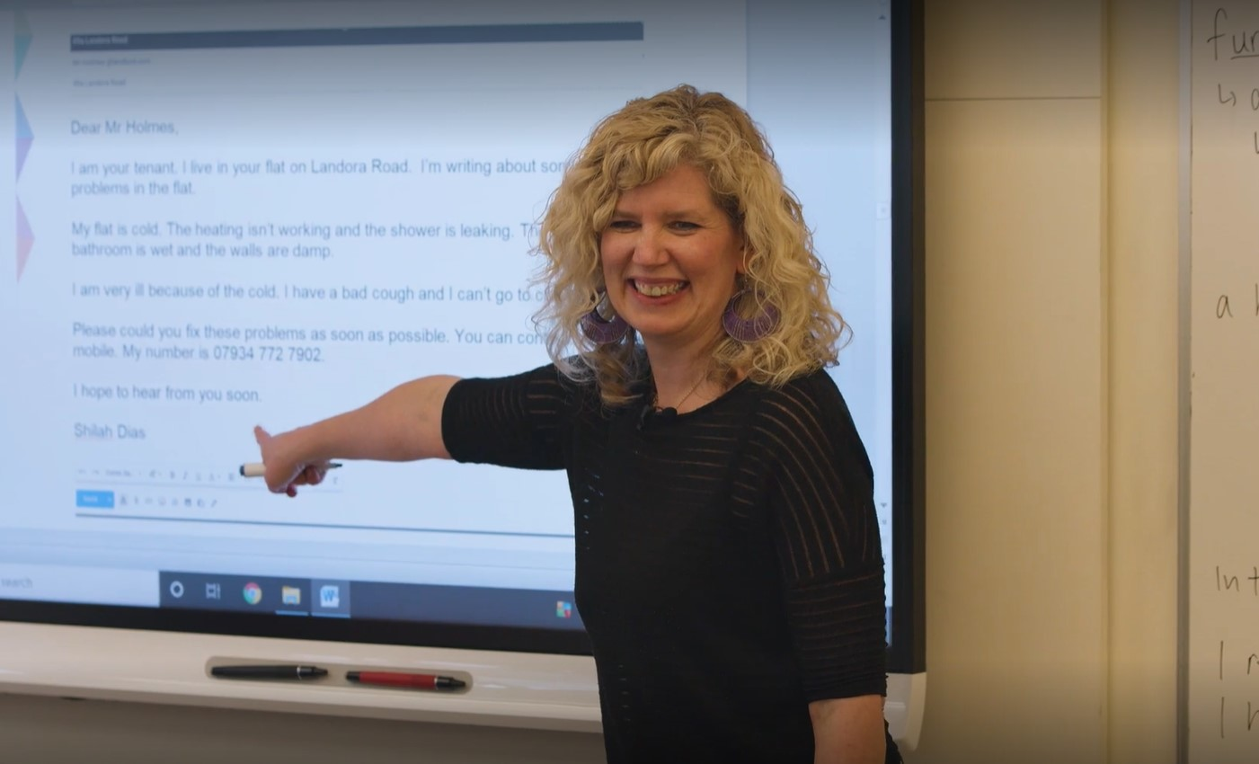
What could I study with the Professional English Department at International House London?

Slide 3
The following are sample Professional English and English for Specific Purposes Course at
International House London

Slide 4
English for Banking and Finance
Monday | Tuesday | Wednesday | Thursday | Friday
0900 to 1200 | 0900 to 1200 | 0900 to 1200 | 0900 to 1200 | 0900 to 1200
Introductions Course content negotiation Mini-presentations BBC FINANCIAL NEWS Listening and discussion Language work: Numbers Skills: Describing graphs and trends Summarizing Homework: FT article | BBC Business News COMPANY FINANCE Balance sheets/P&L Exchanging information Language area: Report writing Skills: Listening and discussion Analysing company annual reports Homework Writing: Company performance | THE STOCK MARKET Vocabulary – Bonds, Futures, Options FT share page DVD: The Markets/Million Dollar Traders Listening and discussion Skills: Telephoning: buying and selling, Checking and clarifying information Homework: Projects | Review BBC Business News Collocations MACROECONOMICS International Trade Import/export Skills: Chairing meetings Role play Homework: Projects | COURSE REVIEW BBC Business News CURRENT FINANCIAL NEWS CORPORATE GOVERNANCE Listening, vocabulary and discussion DVD: Northern Rock, Enron, Lehman Bros
1300 to 1600 | 1300 to 1600 | 1300 to 1600 | 1300 to 1600 | 1300 to 1600
FINANCIAL INSTITUTIONS BANKING SERVICES Loans and savings Vocabulary Listening: The Banks that Robbed The World Language area: Agreeing/disagreeing Discussion techniques | MERGERS and AQUISITIONS Reading: Porsche Skills: The Language of Meetings Problem solving Role play BUSINESS CORRESPONDENCE E-mails SETTING UP PROJECTS | RAISING FINANCE Venture capital Skills: Presentations Reading: Start-up Capital DVD: Dragon’s Den CASE STUDY preparation | INVESTMENT Article: Responsible investing Skills: The Language of Negotiating Suggesting, Compromising Rejecting offers, Interrupting and Clarifying CASE STUDY role play Homework: Summarising an FT article | PROJECTS Vocabulary extension Presentations (filmed) End of course language feedback Q&A Recommendations for further study

Slide 5
English for Human Resources
Monday | Tuesday | Wednesday | Thursday | Friday
0900 to 1200 | 0900 to 1200 | 0900 to 1200 | 0900 to 1200 | 0900 to 1200
Introductions Course Content Negotiation INTERVIEWING Listening: The Selection Interview Vocabulary: Personal qualities Language: Asking for clarification, Checking understanding HOMEWORK: Article Summary | RECRUITMENT 1 Review Reading: Curriculum Vitae Listening: Interviewing a job applicant Vocabulary: Remuneration/Recruitment Language: Asking open and closed questions HOMEWORK: Vocabulary | RECRUITMENT 2 Review Reading: Vacancy advertisements Writing: Vacancy advertisements Vocabulary: Working conditions Language: Indirect questions HOMEWORK: Report writing | APPRAISALS Review Listening: Staff appraisals Writing: Appraisal reports Vocabulary: Company structure Language: Hypothetical questions HOMEWORK: Article summary | DOWNSIZING ISSUES Review Listening: Consulting staff Writing: References Vocabulary: Redundancy Language: Meetings HOMEWORK: Writing Task: references
1300 to 1600 | 1300 to 1600 | 1300 to 1600 | 1300 to 1600 | 1300 to 1600
JOB SATISFACTION Review Discussion: Motivational Theory Listening: Tom Peter’s “The Human . Element” Reading: Article “Fringe Benefits” Language: “Chairing and controlling meetings” | TEAM BUILDING Review Reading: Successful Teams Listening: People Management Discussion: Case Study | CORPORATE CULTURE Review Discussion: Corporate vs. National Culture Listening: Achieving a positive Corporate Culture Discussion: Case Study | RESTRUCTURING Review Reading: Managing Change Listening: Tom Peters “Crazy ways for. . . crazy days” Discussion: Principles of Managing Change | SPECIALIST MODULE To be discussed by the group

Slide 6
English for Procurement
Monday | Tuesday | Wednesday | Thursday | Friday
0900 to 1200 | 0900 to 1200 | 0900 to 1200 | 0900 to 1200 | 0900 to 1200
WELCOME Introductions & Course Outline - Needs Analysis - Course Methodology MATERIALS PROCUREMENT READING The procurement process DISCUSSION Issues in materials procurement WRITING Requests for tender | LANGUAGE FEEDBACK/REVIEW ACCEPTANCE & ACCOUNTABILITY WRITING Letters of acceptance CONTRACTS Clauses LANGUAGE FOCUS Vocabulary/grammar | LANGUAGE FEEDBACK/REVIEW ORDERING & REPORTING Company policy WRITING Placing an order LANGUAGE FOCUS Vocabulary/Grammar | LANGUAGE FEEDBACK/REVIEW HIGH TECHNOLOGY IN PROCUREMENT READING Procurement risk management programs LISTENING New procurement methods LANGUAGE FOCUS Vocabulary/Grammar | LANGUAGE FEEDBACK/REVIEW COMPLIANCE & TAX ISSUES READING Legal issues ROLEPLAY MEETING Discussion on company conformity LANGUAGE FOCUS Vocabulary/Grammar
1300 to 1600 | 1300 to 1600 | 1300 to 1600 | 1300 to 1600 | 1300 to 1600
EXPEDITING MATERIALS Means & issues of delivery/transport LISTENING Supply Chain Management CASE STUDY Logistics LANGUAGE FOCUS Vocabulary/grammar | PLANNING/MANAGING REQUESTS READING Contingency planning DISCUSSION Company procedures LANGUAGE FOCUS Vocabulary/Grammar | SHIPMENT READING Documentation (Bill of lading etc) INSURANCE Dealing with problems/delays LANGUAGE FOCUS Vocabulary/Grammar | CUSTOMS CLEARANCE LISTENING Required documentation CASE STUDY Discussion LANGUAGE FOCUS Vocabulary/Grammar | CONTRACTING POLICIES & PROCEDURES Company policies & procedures DOCUMENTATION Examples COURSE REVIEW

Slide 7
English for Project Management
Monday | Tuesday | Wednesday | Thursday | Friday
0900 to 1200 | 0900 to 1200 | 0900 to 1200 | 0900 to 1200 | 0900 to 1200
Introductions Course content negotiation Mini-presentations Introduction to Project Management Terminology MEETINGS Listening: effective/poor meeting facilitation Language focus: Useful meeting vocabulary | Overview of the project lifecycle Useful language for each phase Practicing stakeholder communications Case study: Analysing a project schedule | Project status updates and reporting Language for identifying risks/issues Listening: Effective/poor team communications | Reading: Common project challenges Vocabulary: Issue resolution Case study: Negotiating project changes | COURSE REVIEW Project closing activities Lessons learned/retrospective Celebrating success language
1300 to 1600 | 1300 to 1600 | 1300 to 1600 | 1300 to 1600 | 1300 to 1600
Reading: What is Project Management? Vocabulary review Writing: Drafting a project charter Homework: Write a 1-page reflection on your experience working on previous projects. What went well? What could have been improved? | Introduction to Gantt chart tools/software Describing a project timeline Writing a project proposal Homework: Find an example of a project plan online. Summarize the key elements in 1 paragraph. | Writing effective emails/memos Leading a team meeting role-play Giving a project update presentation Homework: Record yourself giving a 2-minute project status update. Listen back and identify areas to improve. | Preparing thorough project documentation Using Gantt charts for task tracking Handling scope change requests Homework: Read a case study about a project change/challenge. Write a 250-word memo proposing how you'd handle it. | Final project presentations Instructor role-plays as stakeholders Course review and feedback End of course language feedback Q&A Recommendations for further study

Slide 8
English for IT/Facilities Management
Monday | Tuesday | Wednesday | Thursday | Friday
0900 to 1200 | 0900 to 1200 | 0900 to 1200 | 0900 to 1200 | 0900 to 1200
Introductions Course Content Negotiation INTERVIEWING Terminology for IT and Facilities Describing roles and responsibilities Listening: IT/Facilities site overview | Scheduling IT deployments/Facilities inspections Preparing for site visits Role-play: IT implementation meeting Role-play: Conducting a facilities audit | Working with IT vendors and service providers Reading: Evaluating IT project bids/proposals Case study: Negotiating an IT services contract | IT system failures and incident response Facilities emergency scenarios Case studies: Crisis simulations | IT Cost/Budget Management Facilities Budget Planning and Cost Control Case Study: Propose Cost-Saving Measures
1300 to 1600 | 1300 to 1600 | 1300 to 1600 | 1300 to 1600 | 1300 to 1600
Reading: IT Operations vs. Facilities Operations Vocabulary review Writing: Drafting work orders/tickets Homework: Observe an IT and Facilities environment, take notes | Analyzing reports and documentation Writing practice: IT and Facilities reports Presenting findings Homework: Write up site visit reports for IT and Facilities | Working with Facilities contractors/vendors Negotiations vocabulary and strategies Mock negotiation role-plays Homework: Research and negotiate simulated contracts | Customer service skills Handling IT troubleshooting calls Handling Facilities complaints and concerns Homework: Prepare complaint response scenarios | Final Project Presentations (IT and Facilities) Instructor role-plays as stakeholders Course feedback and review

Slide 9
English for the Modern Workplace
Monday | Tuesday | Wednesday | Thursday | Friday
0900 to 1200 | 0900 to 1200 | 0900 to 1200 | 0900 to 1200 | 0900 to 1200
Introductions and self-assessments Vocabulary: 21st century workforce terms Discussing importance of soft skills Language focus: Active listening | Emotional intelligence vocabulary Describing emotional responses at work Case study: Analyzing a miscommunication | Problem-solving vocabulary and processes Practicing clarifying questions Case study: Breakthrough innovation discussion | Cultural diversity terminology Describing cultural values/perspectives Case study: Cultural viewpoints and miscommunication | Digital literacy terms and virtual workplace Discussing personal branding strategies Case studies: Effective/poor self-marketing
1300 to 1600 | 1300 to 1600 | 1300 to 1600 | 1300 to 1600 | 1300 to 1600
Reading: The Rise of Remote/Hybrid Work Building relationships virtually Vocabulary review Writing: Professional emails/messages Homework: Note examples of good/poor communication | Giving and receiving feedback Role-plays: Resolving workplace conflicts Useful phrases for conflict resolution Homework: Self-reflection - Strengths and improvement areas | Language for leading/participating in meetings Running a collaborative team task Discussing and deciding as a group Homework: Observe a team interaction, analyse communication | Resilience and adaptability vocabulary Strategies for dealing with stress/change Role-plays: Adopting a flexible mindset Homework: Write about a time you demonstrated resilience | Presenting on a 21st century workplace topic Handling Q&A End of course language feedback Q&A Recommendations for further study

Slide 10
Business English Group Classes Sample Based on Needs Analysis of Students
Monday | Tuesday | Wednesday | Thursday | Friday
0900 to 1200 | 0900 to 1200 | 0900 to 1200 | 0900 to 1200 | 0900 to 1200
Welcome Introductions Course Content Negotiation Overview of English tense system Describing your company Past; Present and Future Phonetics and recorded presentation | BBC TV or Radio News Intensive listening Language development and topical discussion Reading People Management How to be a decent employer | Useful phrases 2 Chairing a discussion Role play BBC TV or Radio News Intensive listening Language development and topical discussion Smalltalk recorded | Socialising Listening In a restaurant Cross-Cultural issues National Stereotypes and cross-cultural business practices Reading and Discussion | BBC TV or Radio News Intensive listening Language Video Meeting to Negotiate Role Play Management/Union Salary negotiation
1300 to 1500 | 1300 to 1500 | 1300 to 1500 | 1300 to 1500 | 1300 to 1500
BBC TV or Radio News Intensive listening Language development and topical discussion Management Listening and discussion Managing a team Staff motivation | Excellent Communicators Time Manager Video Language development and discussion Useful phrases Presentations Recorded presentation | Fast Food Challenges facing MacDonalds Video Language development and discussion Recorded presentation The Catering industry in the Czech Republic | BBC TV or Radio News Intensive listening Language development and topical discussion Different management Styles Reading and discussion | Online meetings practice Getting through and being understood Final presentation on video Vocabulary extension Presentations (filmed) End of course language feedback Q&A Recommendations for further study

